Slide 1
Observations and Inferences

Slide 2

In this Smart Lesson you will do the following:
Distinguish between observations and inferences.
Distinguish between qualitative and quantitative data.

Slide 3

Observations only include information gathered through the five senses.
They do not include predictions, guesses, inferences or conclusions.

Slide 4

There is a difference between an observation and an inference.
When a scientist infers, they provide an explanation for an observation they have made.
Inferences are based on prior knowledge and previous experience.

Slide 5

Sometimes several inferences can be made from one observation.
If you observed that Michael was a faster swimmer than Julie, you could infer that he was fitter than Julie or that he has had more swimming lessons.

Slide 6

Observation: When you wake in the morning, you observe that the grass on the front yard is wet.
Some inferences you could make from this observation include that:
• | It rained overnight.
• | A sprinkler was used recently.
• | There is a lot of dew on the grass.

Slide 7

Observation: You observe that the school’s fire alarm is going off.
Some inferences you could make from this observation include:
• | There is a fire drill.
• | There is a fire somewhere in the school.
• | The fire alarm is faulty.

Slide 8

There are two types of observations that scientists make: qualitative and quantitative.
Qualitative observations are descriptive.
They are written down as words or recorded as diagrams, photographs or videos.
Describing the colours of a bird’s feathers or the sound that it makes would be an example of a qualitative observation:

Slide 9
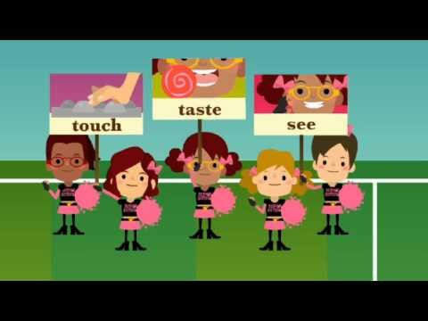

Slide 10
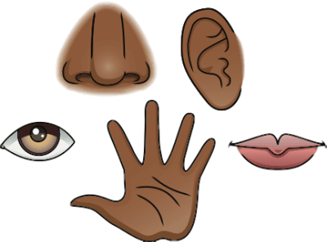
Qualitative data is measured directly.
This is the information you gather by touching, tasting, listening, smelling or looking.
You use your senses to gather qualitative information.

Slide 11

Qualitative data is less accurate than quantitative data.
This is because you estimate when you gather qualitative data.
It is non-numerical data because we do not use numbers for qualitative data.
For example, in the image below, the ladybird is red with black spots:

Slide 12

Quantitative data is measured indirectly.
We use tools like rulers and thermometers to measure quantitative data.
This is very accurate!

Slide 13
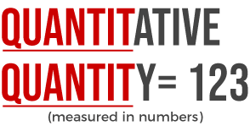
Quantitative data is measured indirectly.
This is numerical data because we use numbers with quantitative data.
Remember:

Slide 14

Quantitative observations involve measurements of what we observe.
They are written down as numbers and include such things as distance, mass, temperature and volume.
For example:
The road is long. (qualitative)
The road is 5 km long. (quantitative)
Both types of observations are valuable in science. However, in experiments, quantitative observations can be precisely and objectively compared.

Slide 15
Quantitative data Vs qualitative data:
Quantitative data is measured indirectly. This is numerical data because we use numbers with quantitative data.
Qualitative data is measured directly. This is the information you gather by touching, tasting, listening, smelling or looking. You use your senses to gather qualitative information.

